Slide 1
Pauline Evgeny Leonidovich
The scientific director of creation the special processor for Moscow’s ABM Don-2N

Slide 2
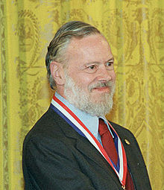
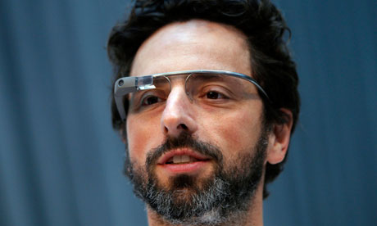
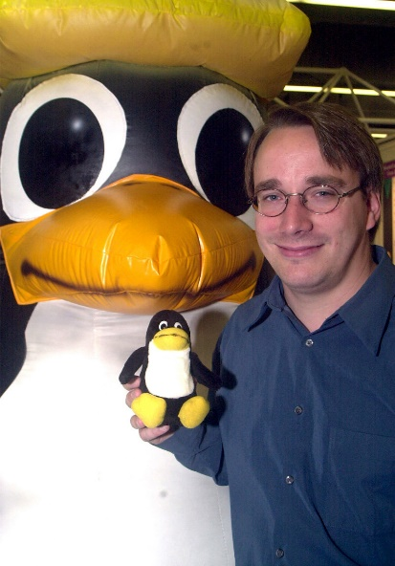
All of you probably know these people?
Dennis MacAlistair Ritchie (September 9, 1941 – October 12, 2011) was an American computer scientist. He created the C programming language and, with long-time colleague Ken Thompson, the Unixoperating system. Ritchie and Thompson received the Turing Award from the ACM in 1983, the Hamming Medal from the IEEE in 1990 and the National Medal of Technology from President Clinton in 1999. Ritchie was the head of Lucent Technologies System Software Research Department when he retired in 2007. He was the "R" in K&R C and commonly known by his username dmr.
Sergey Mikhaylovich Brin (born August 21, 1973) is an American computer scientist and internet entrepreneur who, together with Larry Page, co-founded Google, one of the most profitable Internet companies. As of June 2014, his personal wealth was estimated to be US$ 30 billion. Together, Brin and Page each own about 16 percent of the company.
Brin emigrated to the United States with his family from the Soviet Union at the age of six. He earned his undergraduate degree at the University of Maryland, following in his father's and grandfather's footsteps by studying mathematics, as well as computer science. After graduation, he moved to Stanford University to acquire a PhD in computer science. There he met Larry Page, with whom he later became friends. They crammed their dormitory room with inexpensive computers and applied Brin's data mining system to build a search engine. The program became popular at Stanford and they suspended their PhD studies to start up Google in a rented garage.
Linus Benedict Torvalds (born December 28, 1969) is a Finnish American software engineer, who was the principal force behind the development of the Linux kernel. He later became the chief architect of the Linux kernel and now acts as the project's coordinator. He also created the revision control system Git as well as the diving log software Subsurface. He was honored, along with Shinya Yamanaka, with the 2012 Millennium Technology Prize by the Technology Academy Finland "in recognition of his creation of a new open source operating system for computers leading to the widely used Linux kernel". He is also the recipient of the 2014 IEEE Computer Society Computer Pioneer Award.

Slide 3
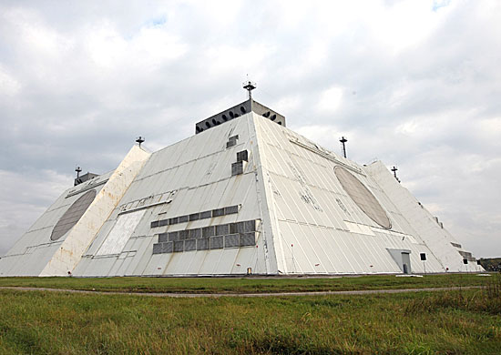
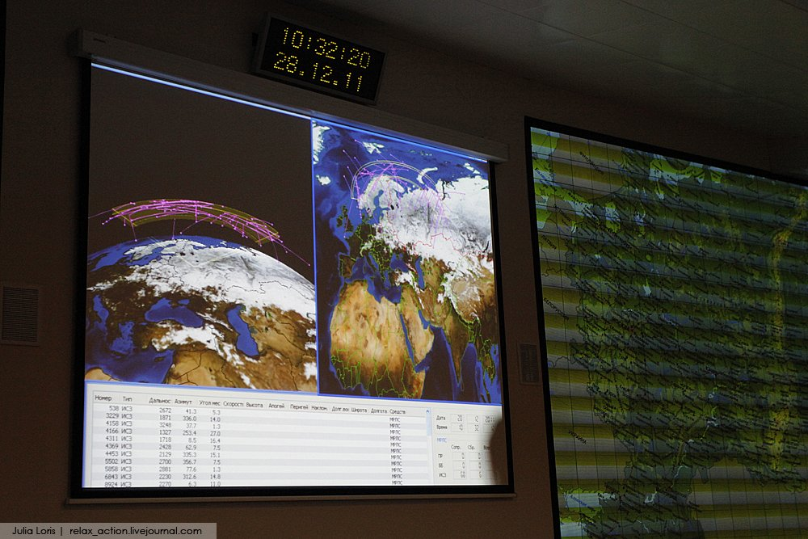
Moscow’s ABM. Don-2N
The Don-2N radar is a large missile defense and early warning passive electronically scanned array radar outside Moscow, and a key part of the Russian A-135 anti-ballistic missile system designed for the defense of the capital against ballistic missiles. Located in the Pushkino district of Moscow it is a quadrangular truncated pyramid 33 meters (108 ft.) tall with sides 130 meters (427 ft.) long at the bottom, and 90 meters (295 ft.) long at the top. Each of its four faces has an 18 meters (59 ft.) diameter UHF band radar giving 360 degree coverage. The system is run by an Elbrus-2 supercomputer.
Under the 1972 Anti-Ballistic Missile Treaty both the United States and the Soviet Union had to designate one area to protect from missile attack. The USA chose North Dakota and the Soviet Union chose Moscow. The Don-2N radar is designed to be the control center of the system and can operate autonomously if connection is lost to its command and control center.

Slide 4
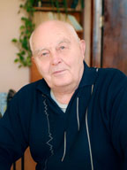
Pauline Evgeny Leonidovich
Evgeny Leonidovich was born in 1937. In 1960 he graduated from the Polytechnic Institute of Odessa, majoring in "Electrical equipment of industrial enterprises and installations". Since 1973, for nearly 20 years, he was the ideological leader and organizer of the formation of the Department "Calculating Machines", directly developed the majority of teaching courses and brought the Department to the top of ten in the USSR. Now he is PhD, Acting Professor Department of Computer intellectual systems and networks. This person does not have a doctoral degree only because the status does not matter for him. After all, during his career, he had published more than 200 scientific works, had more than 150 inventions.

Slide 5
Thank you for your attention
"If it's forbidden but much desired, you are allowed" (c) Pauline
The report presented by Demidenko Andrey

